Slide 1
Geospatial Predictive Modelling for Detection of Vegetation Stress
Lokesh Kumar Bathina
MTech in Geoinformatics, IIT Bombay

Slide 2
Contents
Motivation
Study area
Data Processing
Model
Results

Slide 3
Motivation
An insidious nature hazard (on larger scale)
Agriculture (on smaller scale)
Causes - low precipitation, water supply and nutrient deficiency or some disease
So, accurate monitoring is essential to understand stress progression and potential effects to provide information necessary to support mitigation decisions.
Remote Sensing Data can be helpful for analyzing or determining the plants or trees health

Slide 4
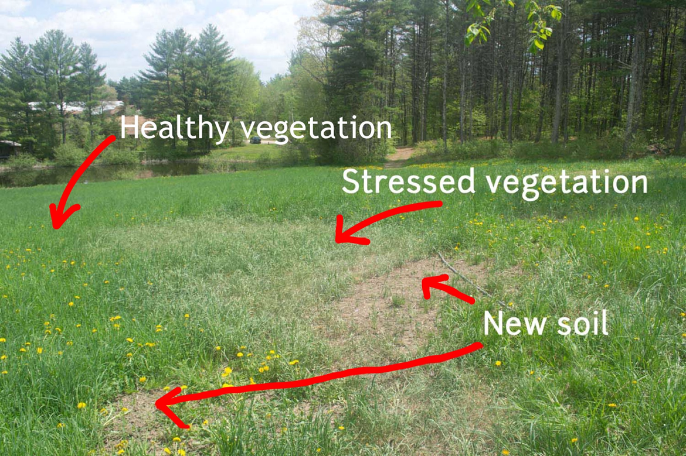

Slide 5
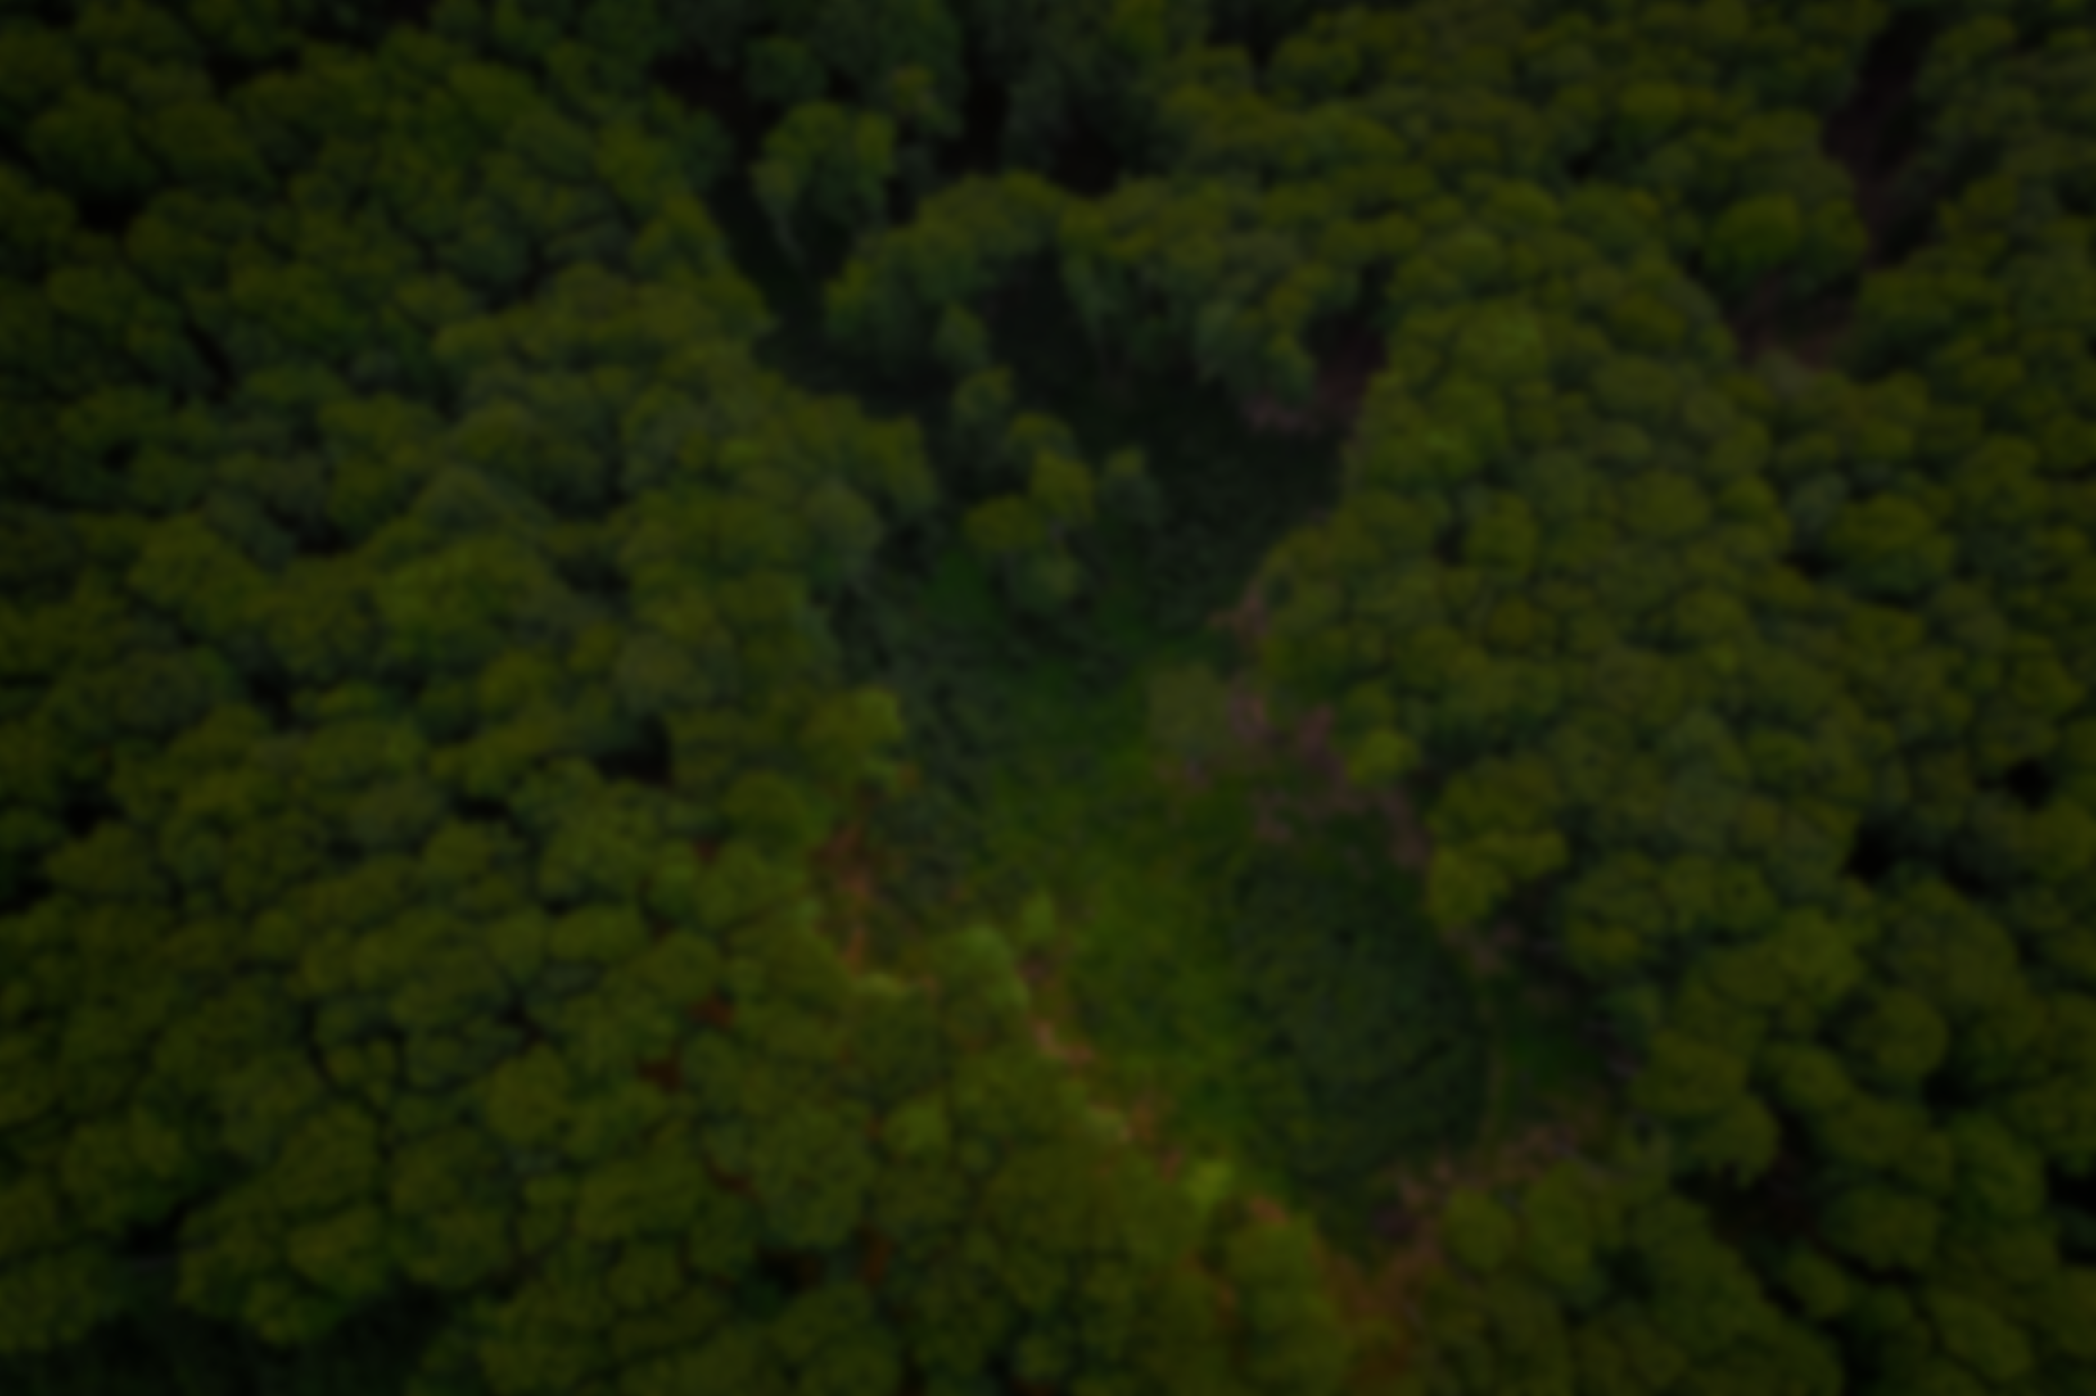
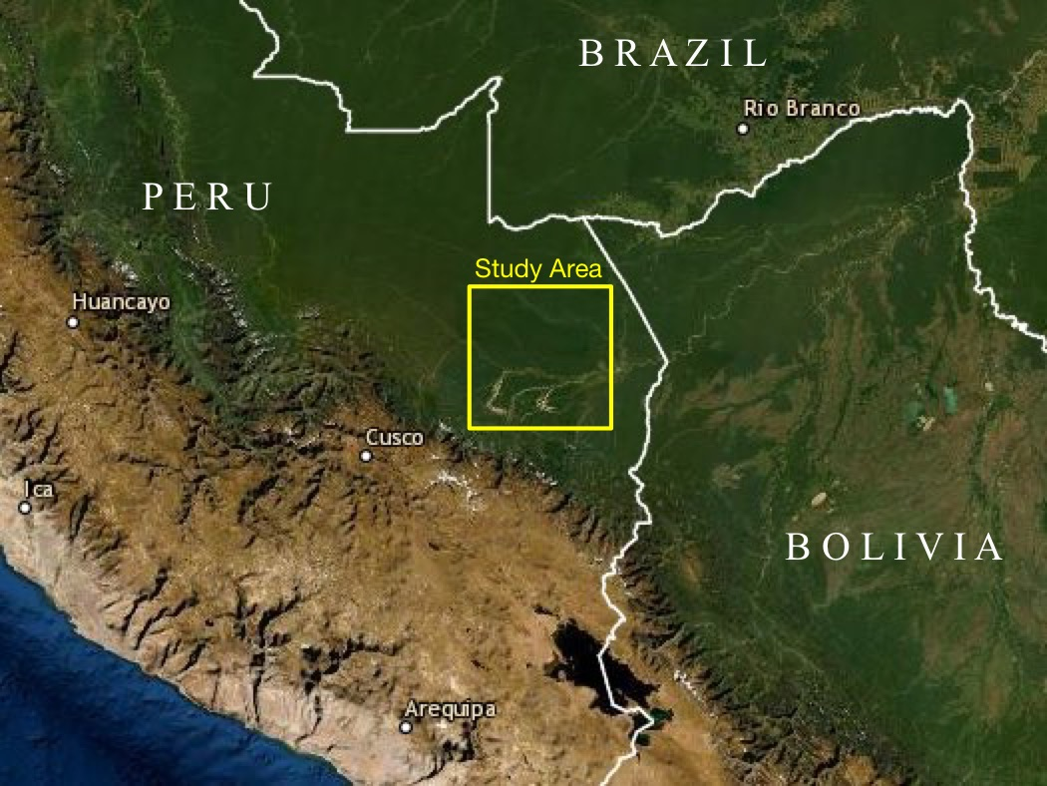
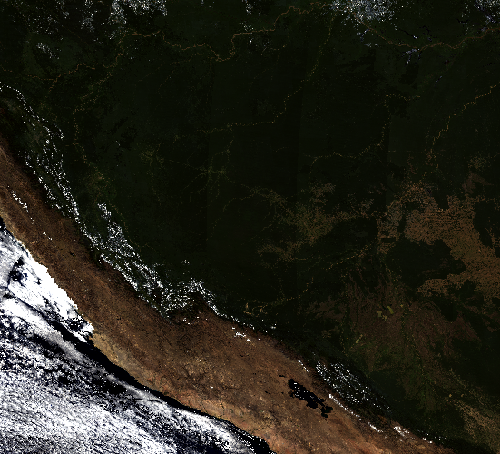
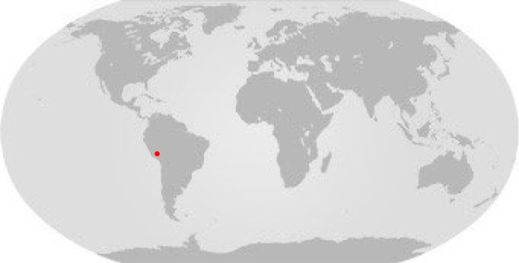
Study Area
Mosaicked Satellite Imagery of our study area
(NASA’s Terra MODIS Surface Reflectance Bands)

Slide 6
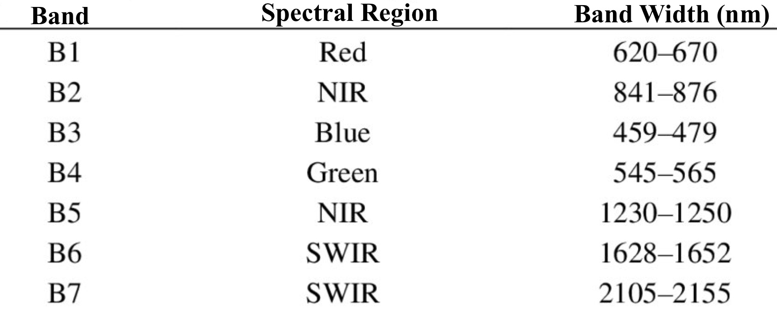
MODIS Surface Reflectance Instrument
Onboard Terra & Aqua Satellites
Spatial Resolution – 500 m
500m Surface Reflectance Bands

Slide 7
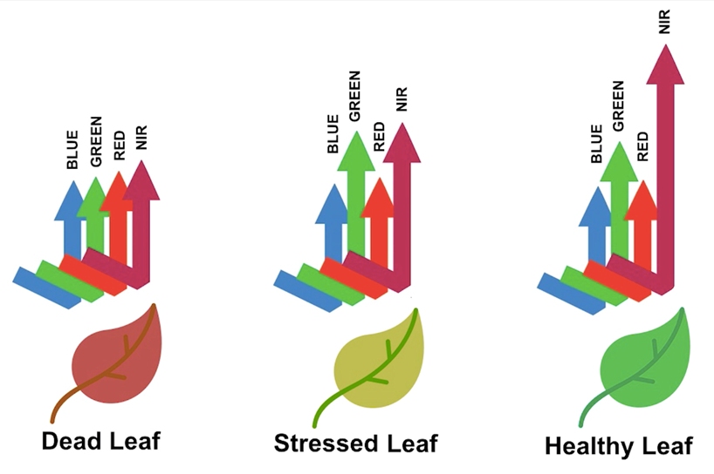
Data Processing & Features Extraction
Understanding Stressed Vegetation Spectrally
NIR, Red and Green Bands

Slide 8
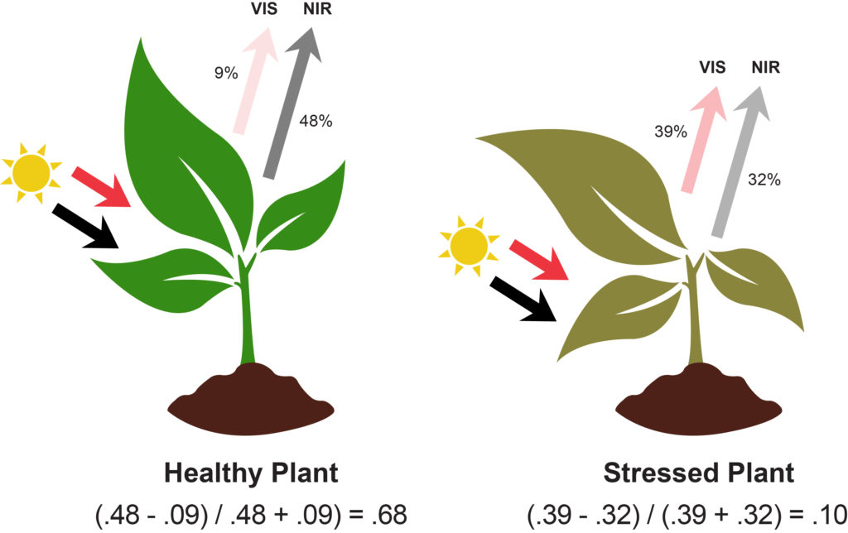

Data Processing & Features Extraction
Normalized Difference Vegetation Index (NDVI)
Indicator of vegetation health
NDVI = $\frac{NIR−RED}{NIR+RED}$

Slide 9
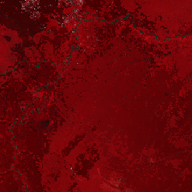
Data Processing & Features Extraction
Gray Level Co-occurrence Matrix (GCM) texture index
Texture of a point is undefined
Image texture is a function of spatial variation in pixel intensity
GCLM - how often pairs of pixel occur in an image
with specific values
in a specified spatial relationship
2nd order statistical measures on GLCM matrix
Single Band
HaralickTextureExtraction tool in QGIS
FCC combination of the study area

Slide 10
Data Processing & Features Extraction
Features as Band Images
NIR Band Image
Red Band Image
Green Band Image
Mean GLCM texture index Image
single Band
HaralickTextureExtraction tool in QGIS
mean GLCM calculated using Raster Calculator
Standard Deviation Band Image
calculated using Raster Calculator
NDVI Band Image
calculated using Raster Calculator
0.1 - 0.33 – class 1 (Stressed Vegetation )
-1 to +1 (except 0.1 to 0.33) – class 0

Slide 11
Data Processing & Features Extraction
Band Image Features to Vector Features
Using GDAL library in QGIS python console converted Raster Band Images to Arrays
Using NumPy and Pandas library generated a csv file:
Input variables: GLCM, NIR, R, G, SD
Target variable: class

Slide 12
Data analysis
Visualized the data for further data analysis and manipulation
Normalized input feature values between 0 and 1
Converted to Array format from Pandas dataframe
Slicing and Splitting the data into training, validation and test datasets

Slide 13
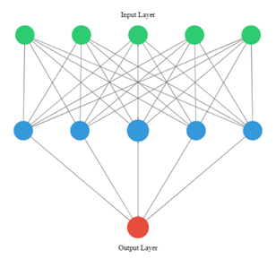
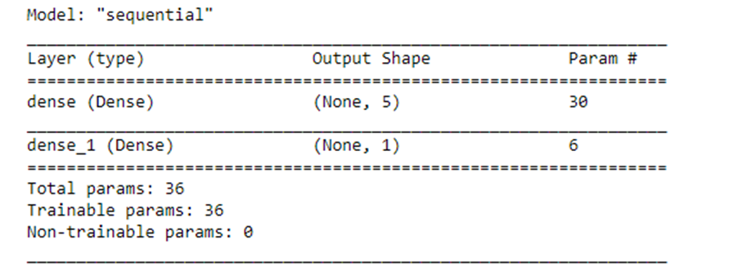
Modelling
Fully-connected 3-layer neural network
Activation function
Hidden layer – ReLU function
Output layer – Sigmoid function

Slide 14
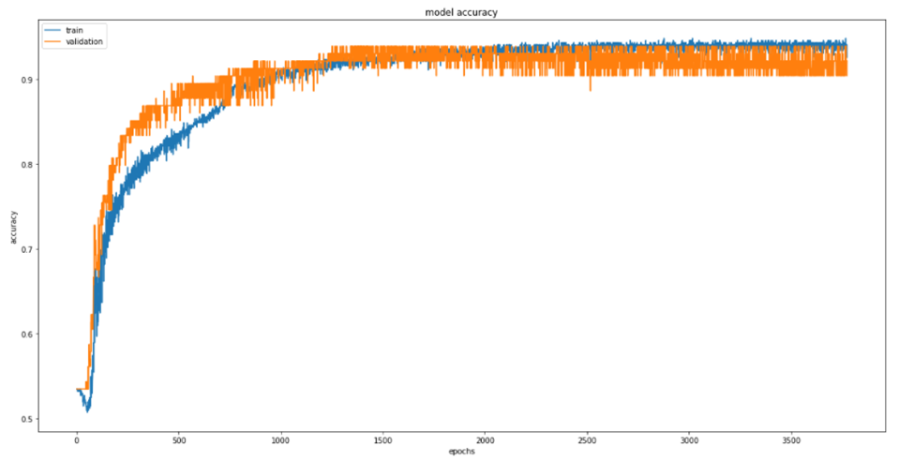
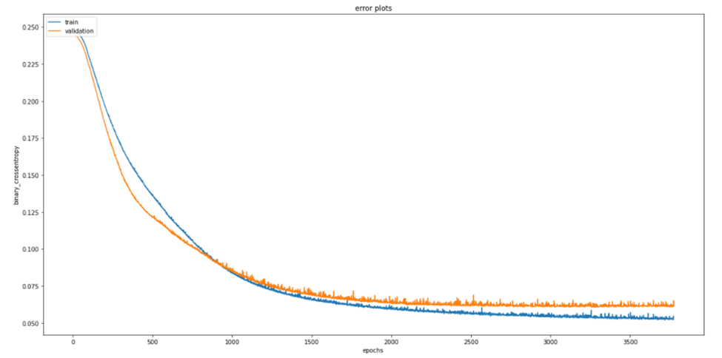
Modelling
Loss function – binary cross entropy
Adam algorithm
Used EarlyStoppiing method for training
Accuracy plots
Error plots

Slide 15
Results
Achieved a state of the art evaluation metrics
achieved an accuracy of 93.10% (number of samples correctly classified),
an error rate of 6.90% (number of samples misclassified),
a sensitivity of 92.11% (model’s ability to predict non-stressed regions), and
a specificity of 95% (model’s ability to predict stressed regions).
GitHub link of the project: https://github.com/lokeshkbathina/Detection-of-vegetation-stress-on-multispectral-remote-sensing-images-using-neural-network

Slide 16
Developments
As AI product
For agriculture purposes, can be integrated with UAVs to monitor and detecting potential harm/effects for improving irrigation efficiency

